Slide 1





JavaScript Tools
Tools for Writing / Editing / Debugging JavaScript Code
Svetlin Nakov
Technical Trainer
www.nakov.com
Software University
http://softuni.bg

Slide 2

Table of Contents
JavaScript Development Tools
Visual Studio 2013
Sublime Text 2 with plugins
WebStorm
Debugging tools
Google Chrome / Opera Developer Tools
Firefox Firebug
Internet Explorer F12
Utilities

Slide 3

JavaScript Tools
Know your Tools!

Slide 4
JavaScript Tools
JavaScript is an interpreted language
It is run and executed by the browser
The means to acquire the JavaScript code are trivial
No matter how or where it is coded
A simple Notepad will do the trick
Yet, there are many tools that easify JavaScript coding
Like editors, debuggers, etc…

Slide 5


JavaScript Development Tools
Coding JavaScript made easy!

Slide 6
JavaScript Development Tools
All a developer needs for coding JavaScript is a text editor
Notepad/Notepad++ will do the trick
Yet, JavaScript is one of the popular guys now
Many, many tools for coding JavaScript
Sublime Text 2 / Sublime Text 3
Visual Studio 2012/2013
Adobe Brackets, Cloud9, Telerik AppBuilder, WebStorm
JavaScript Development Tools for Eclipse

Slide 7
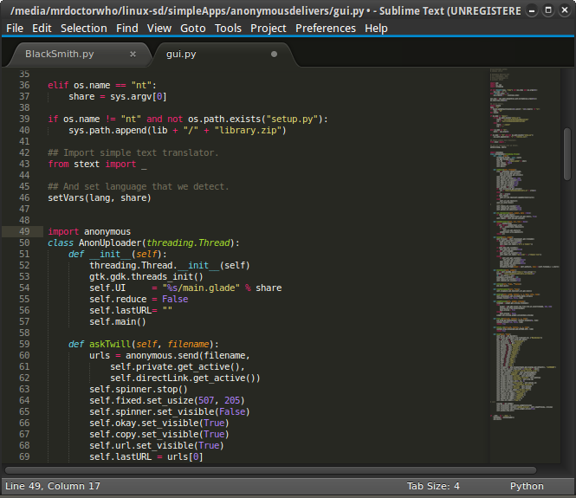
Sublime Text 2
A Lightweight Development Editor for Web Projects

Slide 8
Sublime Text 2
Sublime Text is a sophisticated text editor for code, markup and prose
Free to download: http://www.sublimetext.com/2
Sublime text has many useful features, not directly related to coding
Navigation between files
Multiple selection
Command Palette
Customizable – write your own plugins

Slide 9
Working with Sublime Text 2
Goto Anything
Easier navigation between files
Triggered with [CTRL + P]
Command Palette
Execute commands
Triggered with [CTRL + SHIFT + P]
Multiple Selection
Change at multiple places at the same time
Hold [CTRL + right-click]

Slide 10
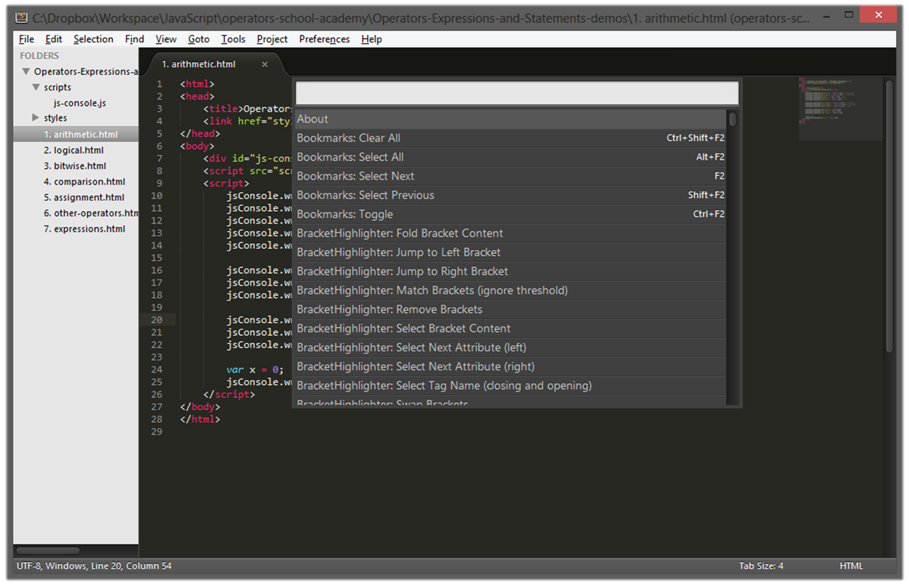
Working with Sublime Text 2
Live Demo

Slide 11
Sublime Text 2 Plugins
Plugins extend the power of Sublime Text
Code highlighting
Auto completion / IntelliSense
And more
Plugins can be installed two ways:
Download the package, paste it in a special folder and go
C:\Users\[user]\AppData\Roaming\Sublime Text 2\Packages
Or, install the “Package Control” plugin and then install plugins directly from Sublime Text

Slide 12
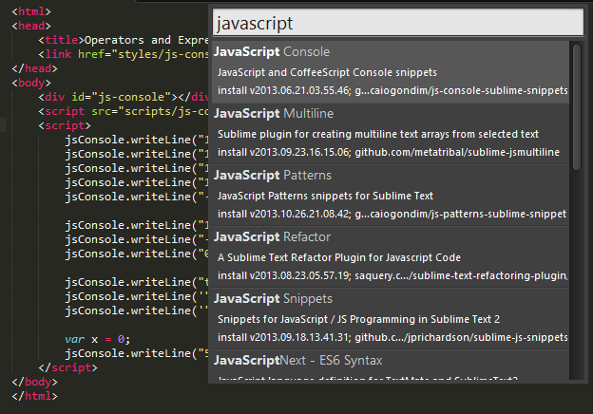
Installing Plugins for Sublime Text 2
Live Demo

Slide 13
Sublime Text 2 Useful Plugins
There are almost indefinite number of Sublime Text 2 plugins
List of useful Sublime Text 2 plugins
IndentGuides – marks the indents (tabs)
StatusBarExtension – adds encoding to the status bar
ClipboardHistory – history of Copy & Paste
Nettuts+ Fetch – easier fetching of files
SiderBarEnhancements – extensions to sidebars
SublimeCodeIntel – adds code intellisense

Slide 14
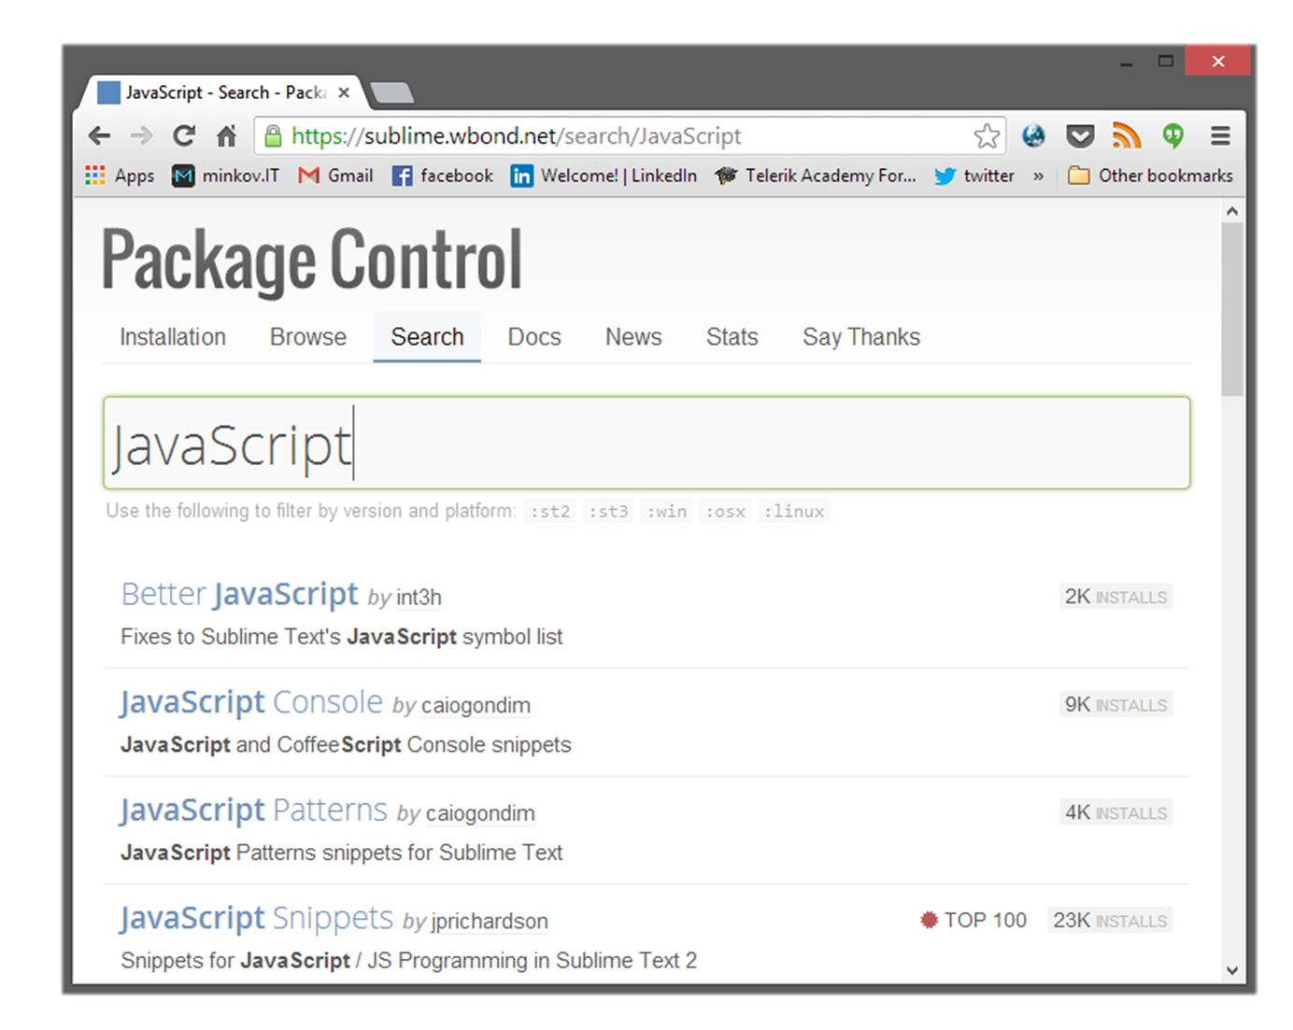
Sublime Text 2 Plugins
Live Demo

Slide 15
Sublime Text 2 JavaScript Plugins
List of useful plugins for JavaScript development:
Less2css – compiles LESS code to CSS
JsFormat – formats JS code
SublimeLinter – adds static code analysis for JS
BracketHighligher – highlights opening and closing brackets
jQuery – adds jQuery bundles

Slide 16
Sublime Text 2 Plugins for JavaScript
Live Demo

Slide 17
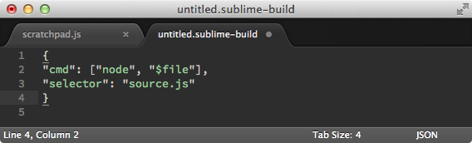
Running JavaScript in Sublime Console
Install Node.js http://nodejs.org/
Go to Tools -> Build System -> New Build System
Save the file as node.sublime-build in default “user” folder
Build the JavaScript file – CTRL + B

Slide 18
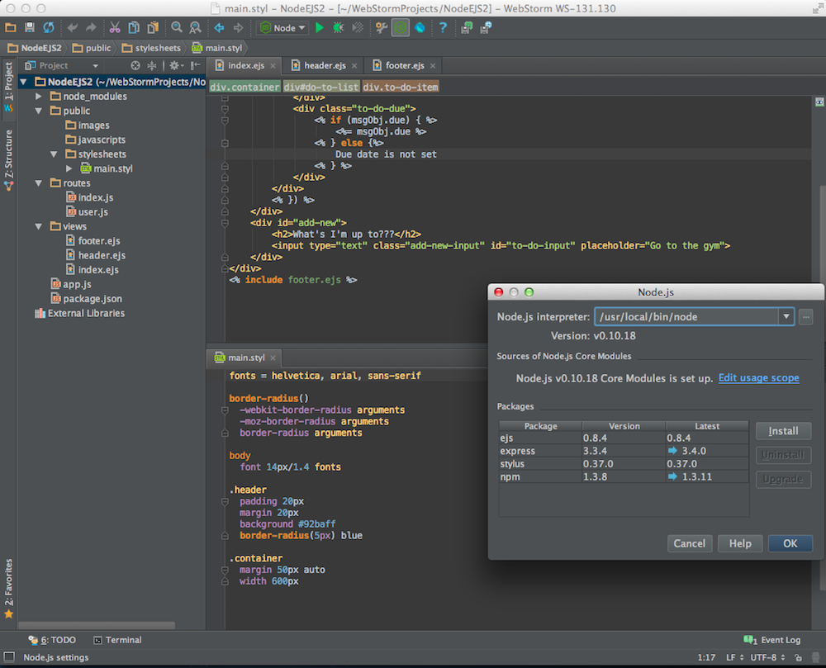
WebStorm
The Smartest JavaScript IDE

Slide 19
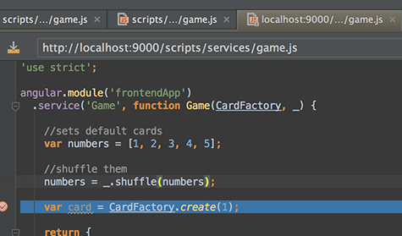
WebStorm
JavaScript IDE suitable for both client-side JS and server-side (Node.js) development
Build JavaScript code
Debug JavaScript code
Code intellisense for:
SASS/LESS/Stylus CSS preprocessors
CoffeeScript/TypeScript JavaScript preprocessors
Emmet coding
Paid product (free 1 year license for SoftUni student)

Slide 20

Visual Studio

Slide 21
Visual Studio
Visual Studio is the main dev tool for creating .NET apps
ASP.NET, WPF, Silverlight, SharePoint, Windows 8, etc…
Until Windows 8 and version 2012, Visual Studio was not a pleasant tool for coding JavaScript
Microsoft put JavaScript into the core of Windows 8, so their development tool needed to be done right
Use Visual Studio 2012 or Visual Studio 2013

Slide 22
Visual Studio 2012/2013
VS 2012/2013 are pretty much ready-to-use for JavaScript coding
They have pretty good intelli-sense, code highlighting, etc…
There are paid and free versions (Visual Studio 2012/2013 Web Developer)

Slide 23
Visual Studio 2012/2013
Live Demo

Slide 24
Debugging JavaScript
Using All the Tools

Slide 25
Debugging JavaScript
Sadly, no intelligent way of debugging client-side JavaScript
The only way to debug JavaScript is through the browser
Fortunately all browsers have their own debugging tool/plugin that makes it easier
Firefox has Firebug
Chrome and Opera have Web Developer Tools
Internet Explorer has [F12]

Slide 26
Debugging JavaScript
Live Demo

Slide 27
JavaScript Utilities
Tools for JS Developers

Slide 28
JavaScript Utilities
JavaScript Code Quality Tools
http://www.jshint.com
http://www.jslint.com
HTML, CSS and JavaScript playgrounds
http://jsbin.com
http://liveweave.com
JavaScript performance tester
http://jsperf.com

Slide 29
JavaScript Utilities
Live Demo

Slide 30


Summary
JS Developer Tools
Sublime Text
WebStorm
Visual Studio
JS Debuggers
The [F12] Tools
JS Utilities
JSHint, JSLint, JSBin, …
JS Basics

Slide 31
JavaScript Tools
https://softuni.bg/courses/javascript-basics/

Slide 32
License
This course (slides, examples, demos, videos, homework, etc.) is licensed under the "Creative Commons Attribution-NonCommercial-ShareAlike 4.0 International" license
Attribution: this work may contain portions from
“JavaScript Basics" course by Telerik Academy under CC-BY-NC-SA license

Slide 33





Free Trainings @ Software University
Software University Foundation – softuni.org
Software University – High-Quality Education, Profession and Job for Software Developers
softuni.bg
Software University @ Facebook
facebook.com/SoftwareUniversity
Software University @ YouTube
youtube.com/SoftwareUniversity
Software University Forums – forum.softuni.bg

